Slide 1


Unit 3: Lesson 10
Are you a foodie?

Slide 2
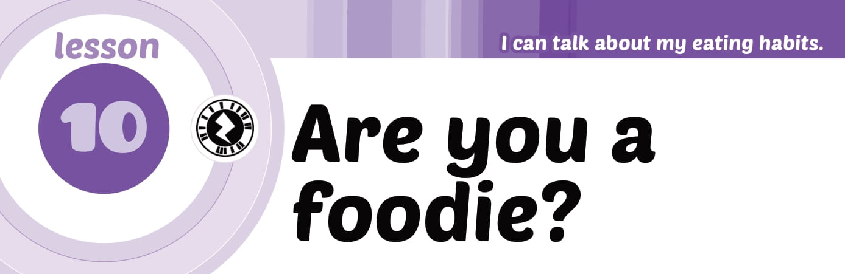

Slide 3
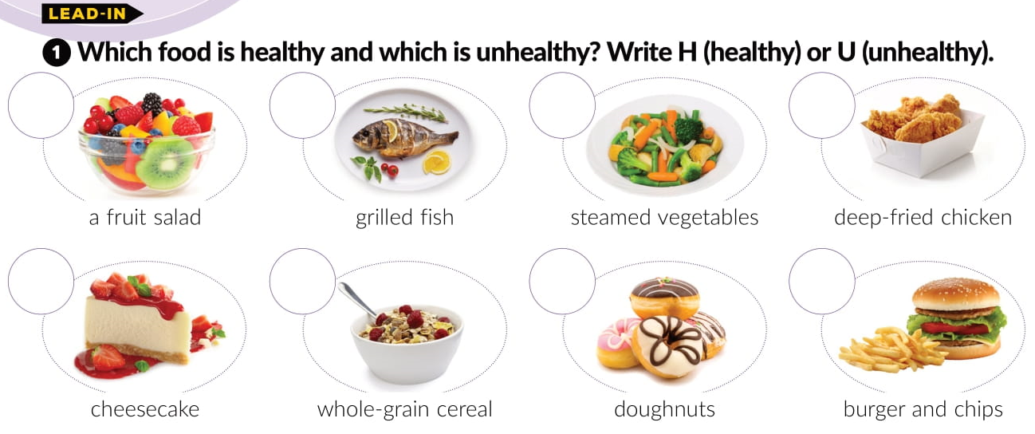
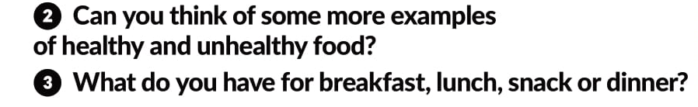
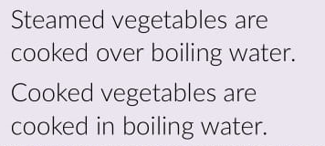
H
H
H
U
H
H
U
U

Slide 4
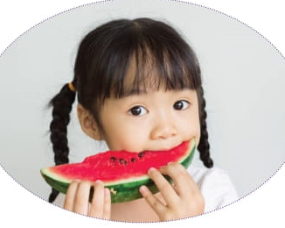
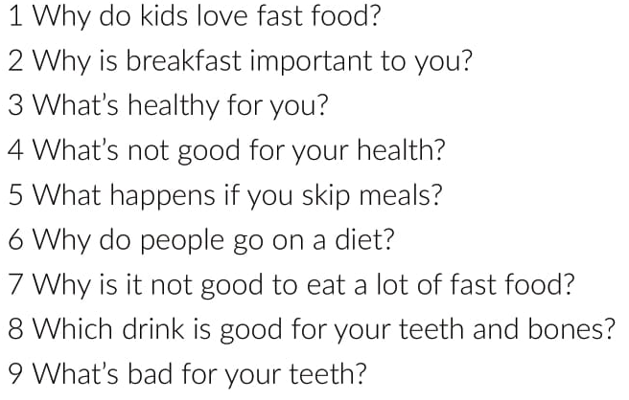
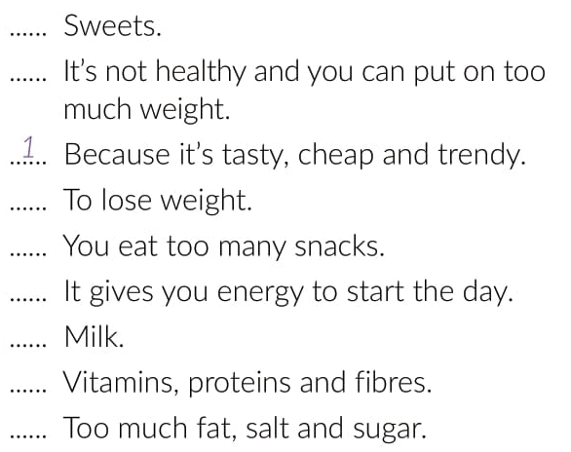
9
7
6
5
2
8
3
4

Slide 5
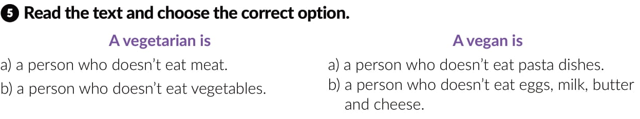
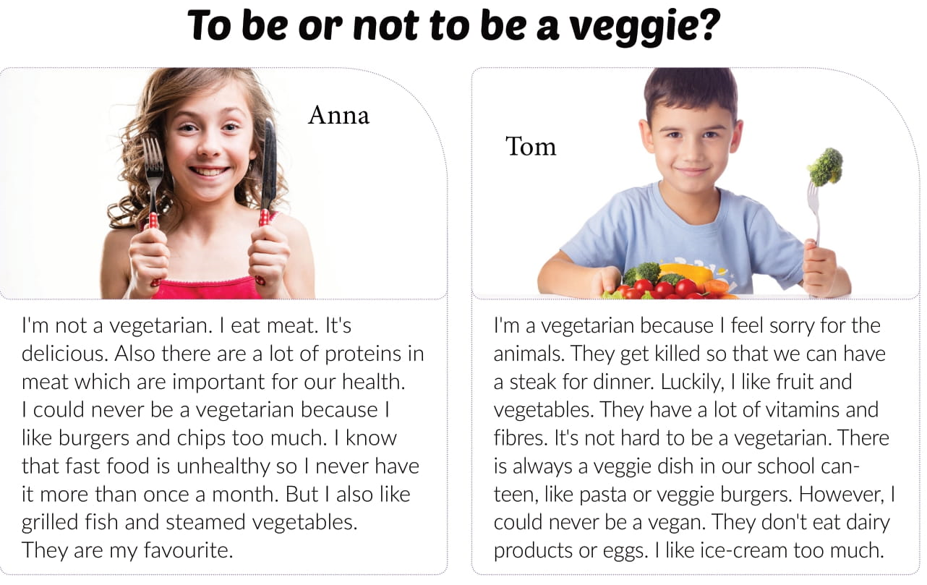

Slide 6
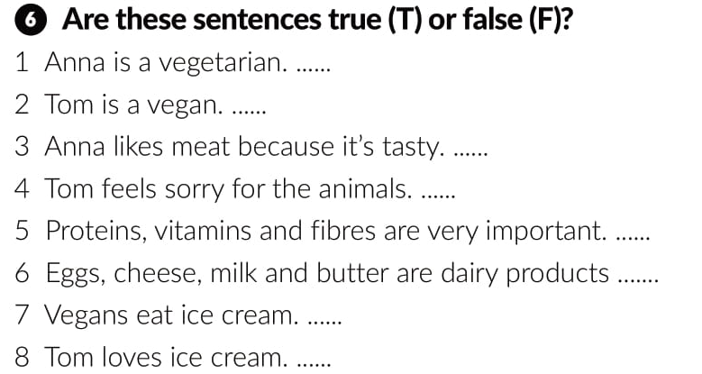
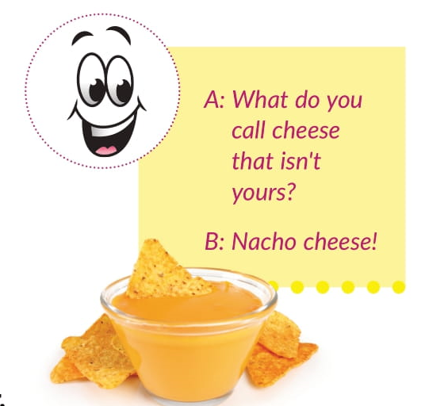
F
F
T
T
T
F
F
T

Slide 7


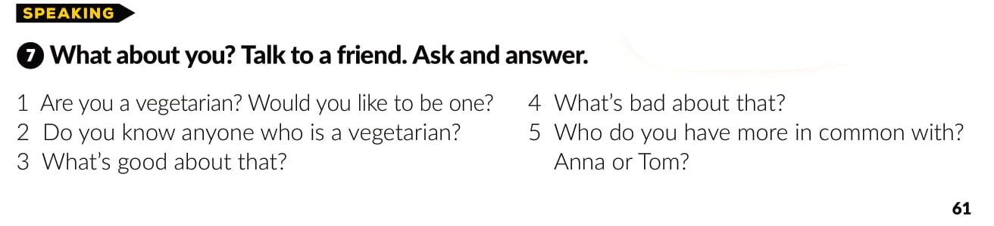

Slide 8
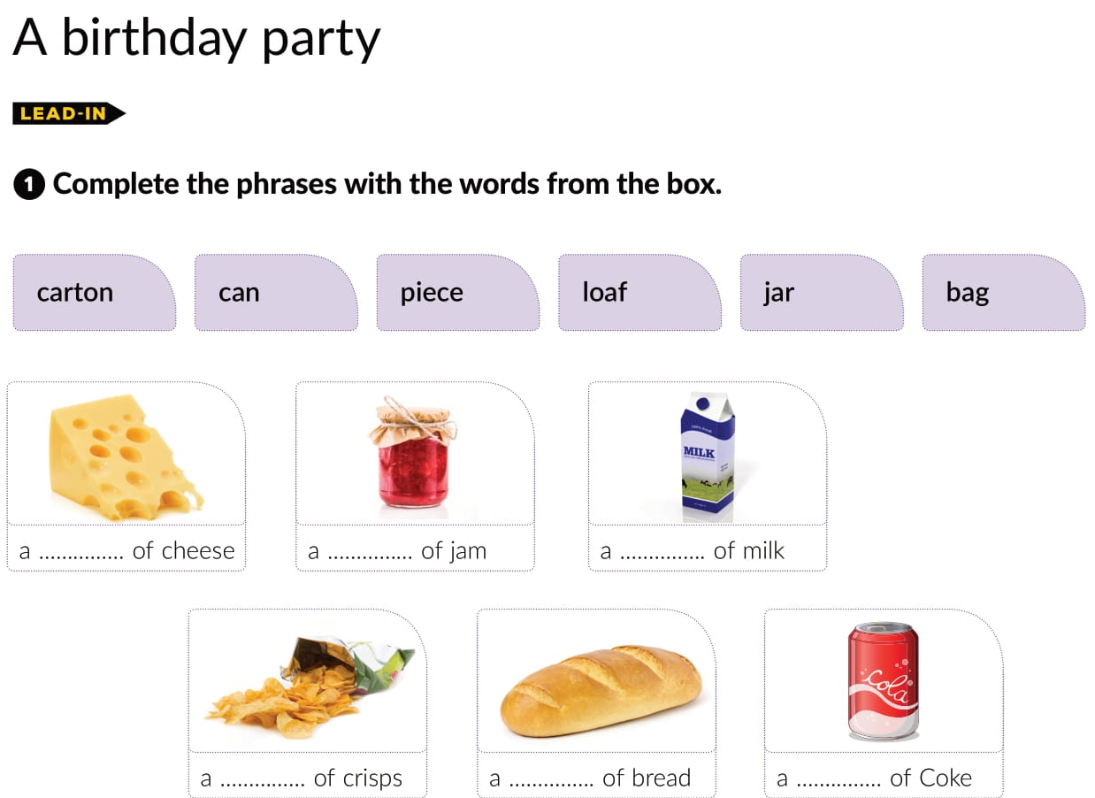
piece
jar
carton
bag
loaf
can

Slide 9
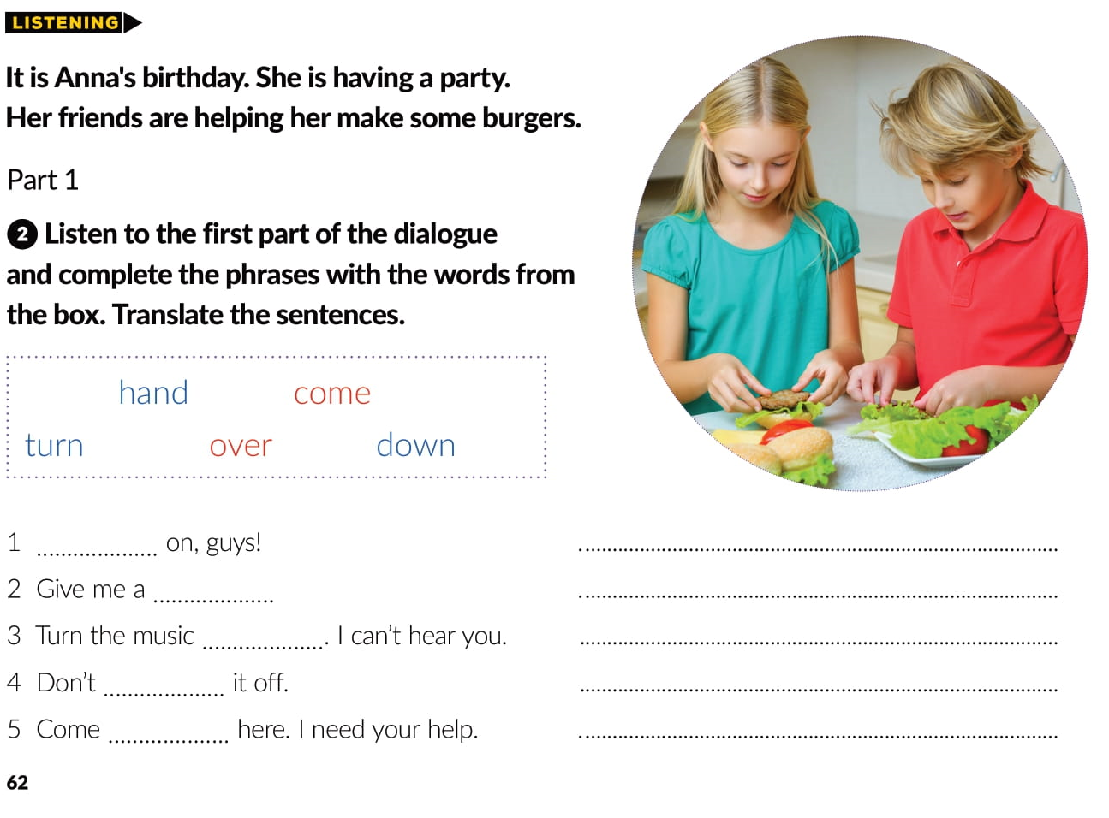

Come
Hajde, ekipa!
hand
Pomozite mi.
down
Stišaj muziku. Ne čujem te.
turn
Nemoj je gasiti.
over
Dođite ovamo. Trebam vašu pomoć.

Slide 10
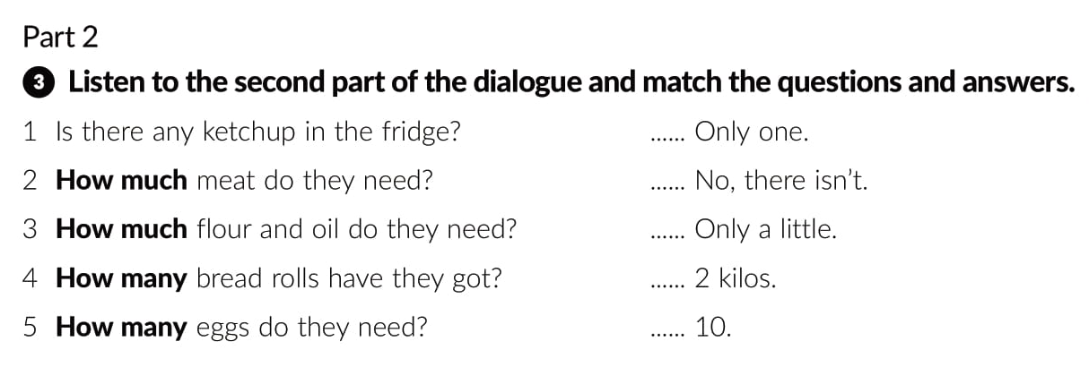
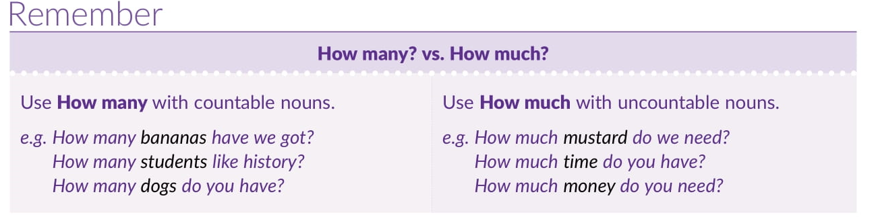
5
1
3
2
4

Slide 11
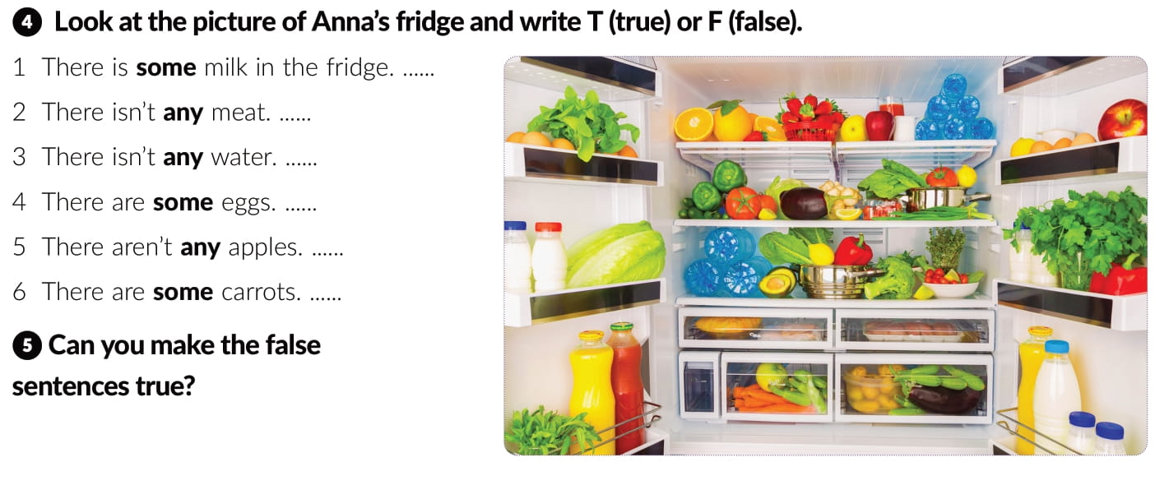
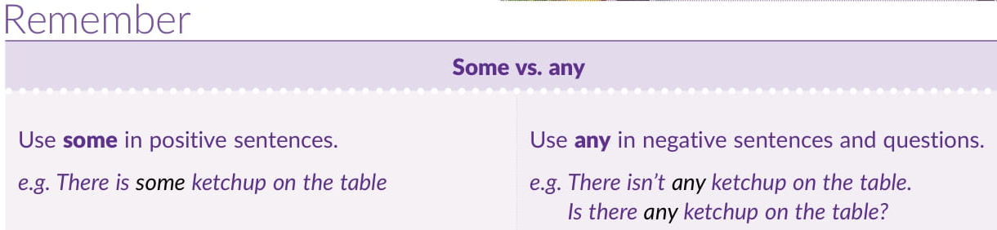
T
F
F
F
F
T

Slide 12
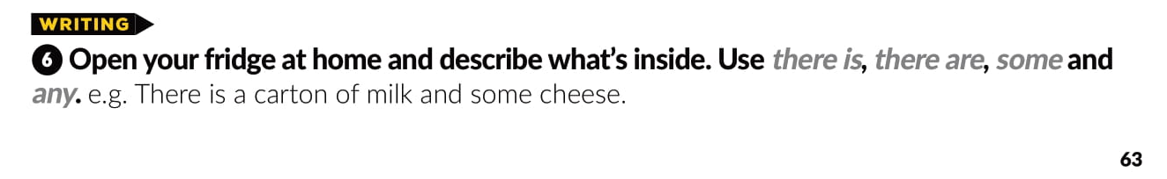
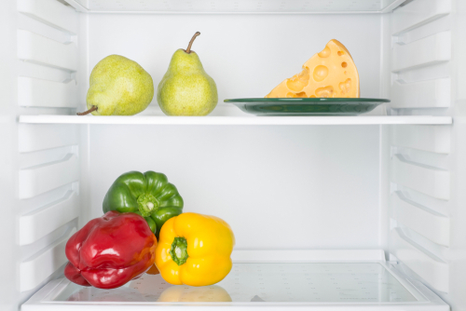

Slide 13
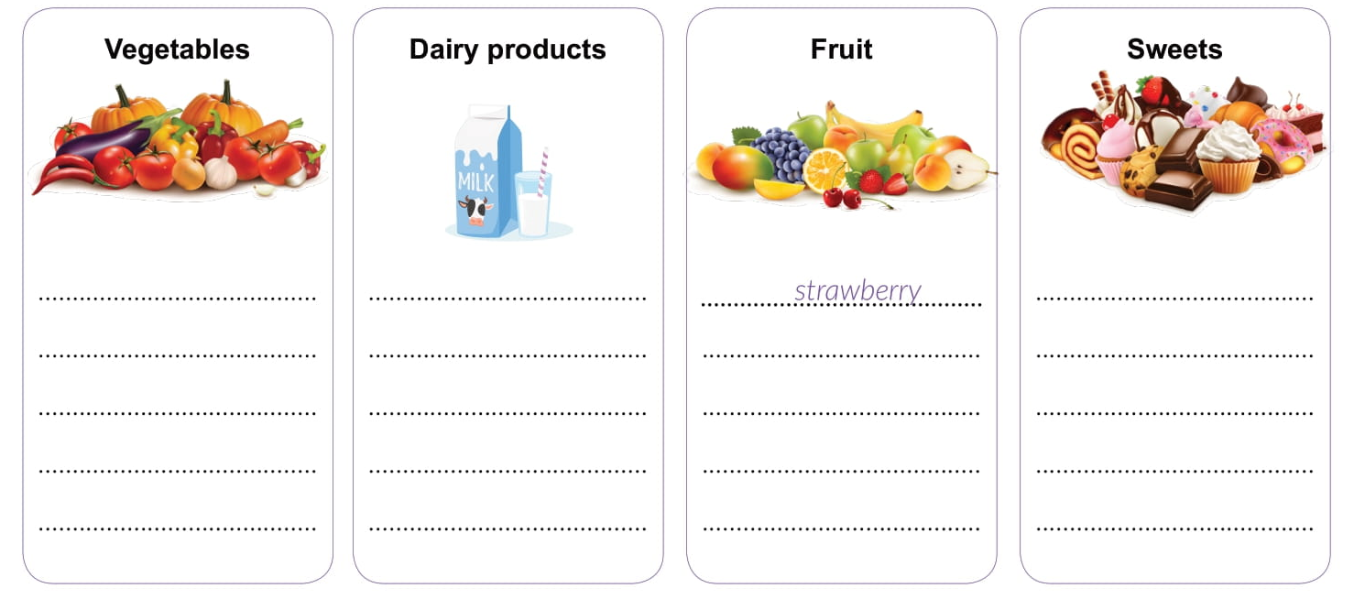
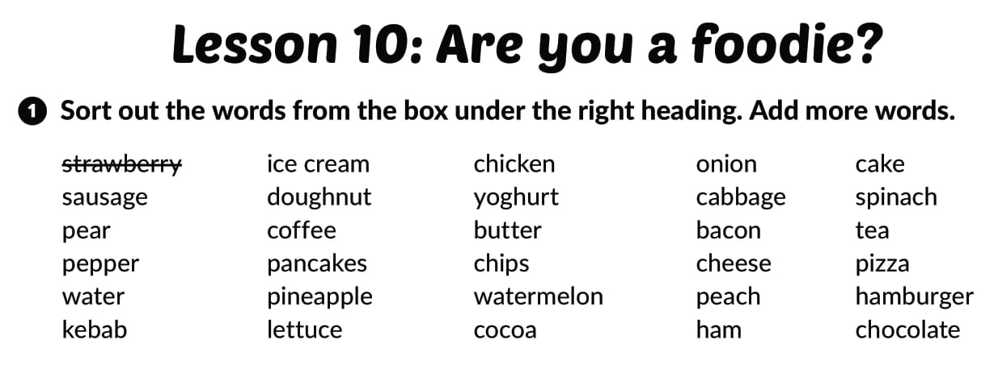
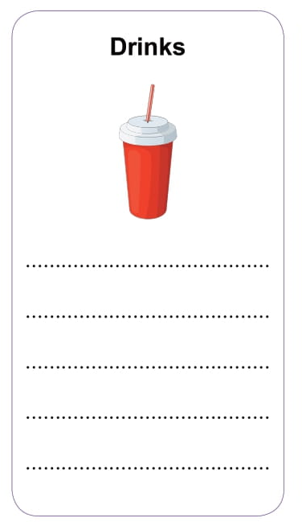
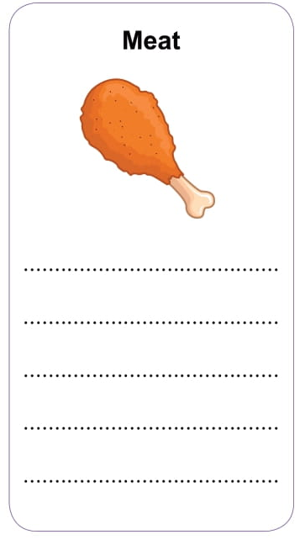
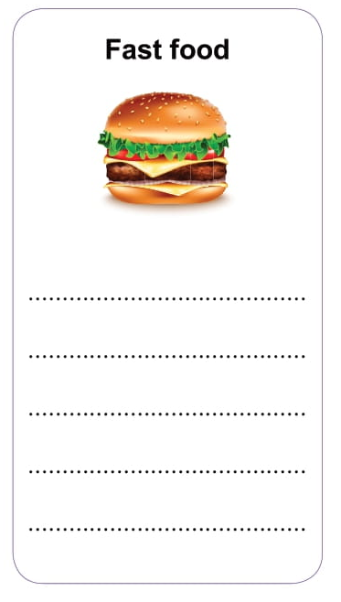
pepper
lettuce
onion
cabbage
spinach
yoghurt
butter
cheese
ice cream
doughnut
pancakes
cake
chocolate
pear
pineapple
peach
watermelon
Workbook, p. 46
water
coffee
tea
cocoa
saussage
kebab
chicken
bacon
ham
chips
pizza
hamburger

Slide 14
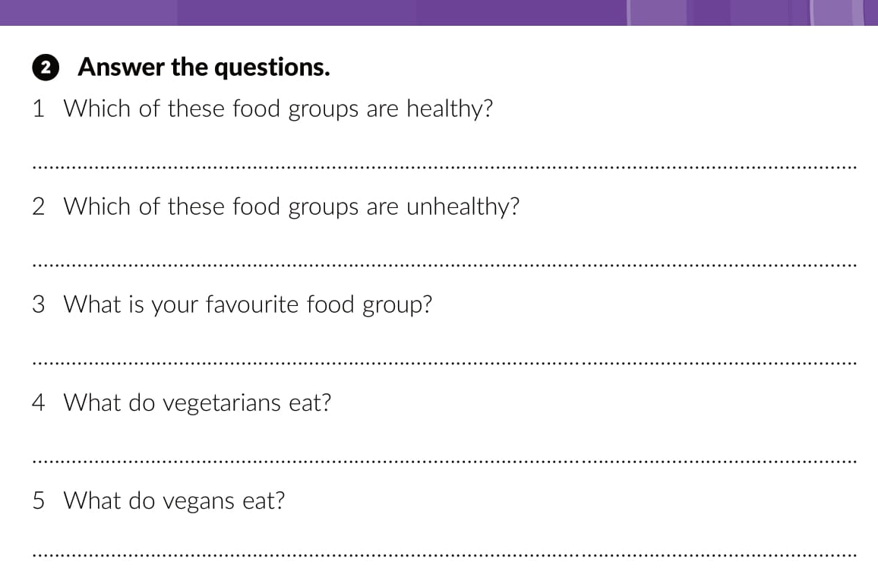
Fruit and vegetables, and dairy.
Sweets and fast food.
Fruit and vegetables, and dairy. They don’t eat meat.
Only fruit and vegetables. They don’t eat dairy, eggs and meat.

Slide 15
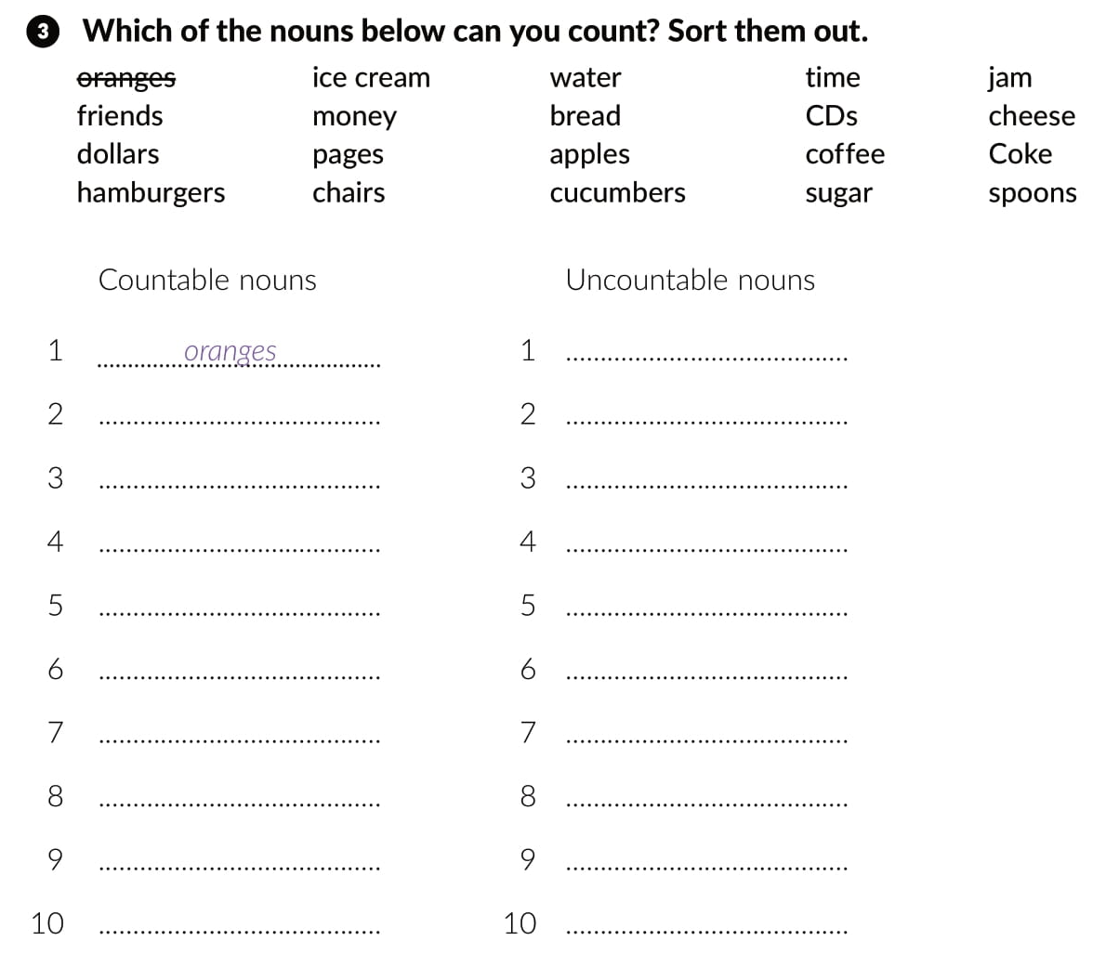
ice cream
money
water
bread
time
coffee
sugar
jam
cheese
Coke
friends
dollars
hamburgers
pages
chairs
apples
cucumbers
CDs
spoons

Slide 16
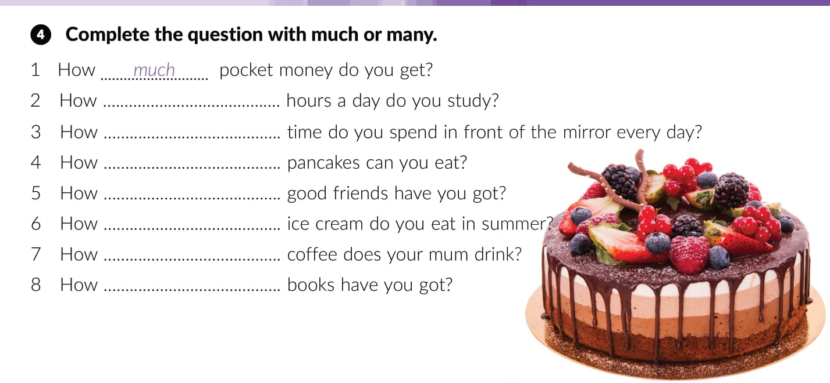
many
much
many
many
much
much
many

Slide 17
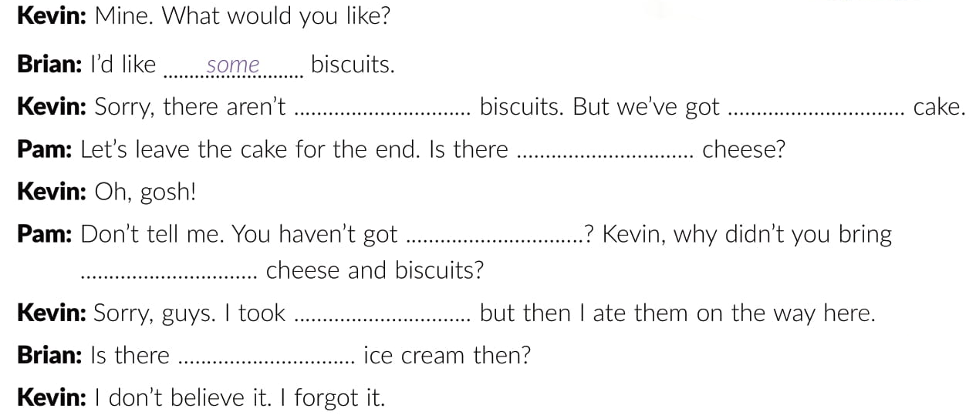
any
some
any
any
some
some
any

Slide 18
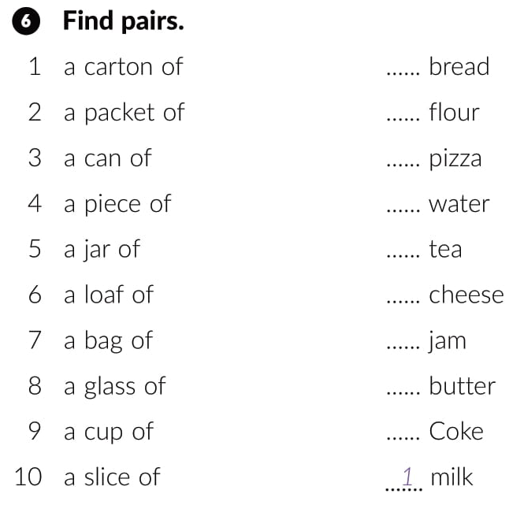

6
7
10
8
9
4
5
2
3

Slide 19
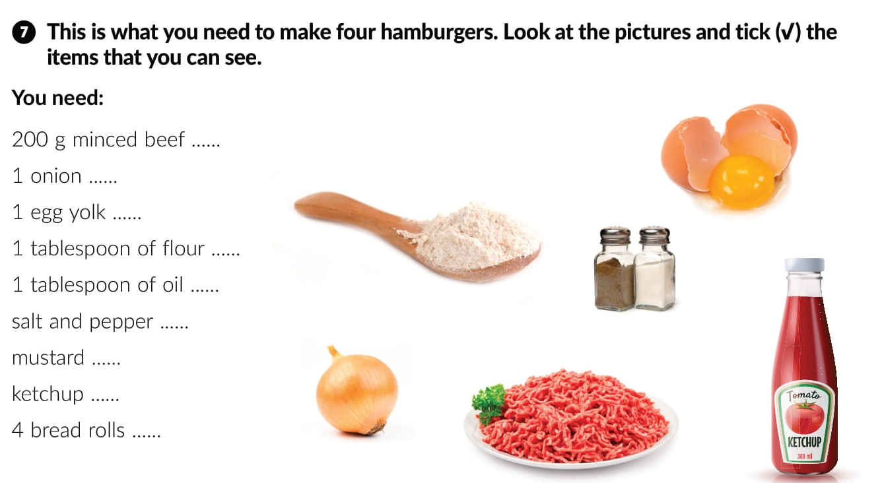


Slide 20
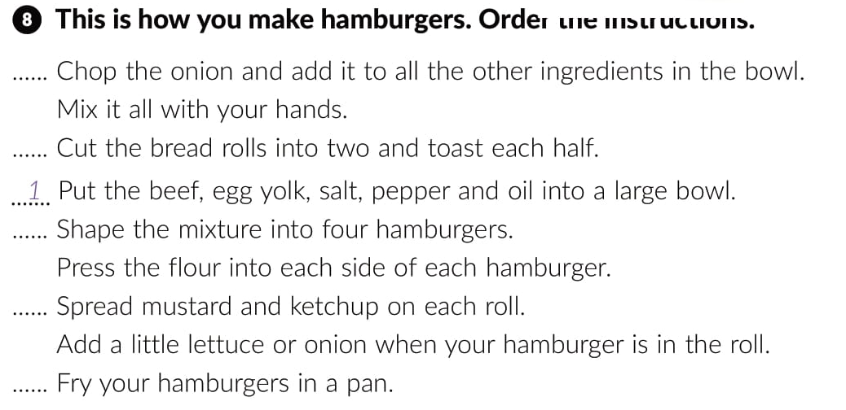
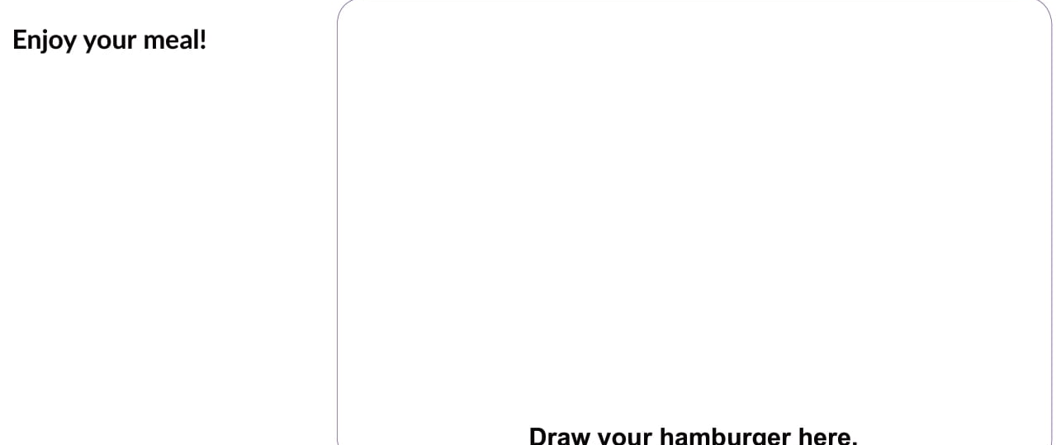
2
5
3
6
4

Slide 21

PLAY AND LEARN
Lesson 10 Are you a foodie | Way to go 3 (e-sfera.hr)

